Slide 1
Foundations of Learning and Adaptive Systems
Evolutionary Algorithms

Slide 2
Evolutionary Algorithms
Genetic
Programming
Evolution
Strategies
Genetic
Algorithms
Classifier
Systems
Evolutionary
Programming
Each of these constitutes a different approach, however, they are inspired by the same principles of natural evolution.

Slide 3
Literature
Goldberg, D. “Genetic Algorithms in Search and Optimization
  Addison-Wesley, Reading MA, 1989
Mitchell, M. “An Introduction to Genetic Algorithms”
  MIT Press, Cambridge, MA, 1996
Koza, J. “Genetic Programming II”
  MIT Press, Cambridge, MA, 1994
Holland, J. “Adaptation in Natural and Artificial Systems”
  Univeristy of Michigan Press, Ann Arbor, 1975
Bäck, Th. “Evolutionary Algorithms in Theory and Practice”
  Oxford University Press, New York, 1996

Slide 4
Outline
Terminology
Genetic Algorithm Overview
Simple genetic algorithm (SGA)
Operators
Encoding
Selection
Examples
Genetic programming

Slide 5
Biological Terminology
Gene
  functional entity that codes for a specific feature e.g. skin complexion, eye color
  set of possible alleles
Allele
  value of a gene e.g. blue, green, brown
  codes for a specific variation of the gene/feature
Locus
  position of a gene on the chromosome
Genome
  set of all genes that define a species
  the genome of a specific individual is called genotype
  the genome of a living organism is composed of several
  chromosomes
Population
  set of competing genomes/individuals
Notes:
In GA’s genome and chromosome are used as synonyms
These terms are used freely in GA terminology although the biological counterparts
are by far more complex and sophisticated

Slide 6
Genotype versus Phenotype
Genotype
  blue print that contains the information to construct an
  organism e.g. human DNA
  genetic operators such as mutation and recombination
  modify the genotype during reproduction
  genotype of an individual is immutable
    (no Lamarckian evolution)
Phenotype
  physical make-up of an organism
  selection operates on phenotypes
  Darwin’s principle : “survival of the fittest”

Slide 7
Genetic Algorithms Overview
Genetic algorithms are inspired by Darwin's theory of natural selection and based on the principle of survival of the fittest
Basic components of genetic algorithms
  A representation of solutions to the problem
  A way to create an initial population
  A fitness function to evaluate the solutions
  A selection mechanism to pick parents for reproduction, and crossover and mutation operators to alter the genetic composition of offspring
  Values for the parameters of genetic algorithms

Slide 8
Evolutionary Algorithm
mutation
population of genotypes
10111
10001
10011
phenotype space
00111
01001
11001
01001
01011
f
coding scheme
recombination
selection
x
10011
10
10
10001
011
001
10001
fitness
01001
10001
01
01
01011
001
011
11001
01011

Slide 9
Pseudo Code of an Evolutionary Algorithm
Create initial random population
Evaluate fitness of each individual
yes
Termination criteria satisfied ?
stop
no
Select parents according to fitness
Recombine parents to generate offspring
Mutate offspring
Replace population by new offspring

Slide 10
Genotype Operators
Recombination (Crossover)
  combines two parent genotypes into a new offspring
  generates new variants by mixing existing genetic material
  stochastic selection among parent genes
Mutation
  random alteration of genes
  maintain genetic diversity

Slide 11
Crossover
crossover applied to parent strings with
probability p_{c} [0.6..1.0]
crossover site chosen randomly
one-point crossover
parent A
parent B
1 1 0 1 0
offspring A
offspring B
1 1 0 1
1
1 0 0 0 1
1 0 0 0
0
two-point crossover
parent A
parent B
1 1 0 1 0
offspring A
offspring B
1 1
0 0
0
1 0 0 0 1
1 0
0 1
1

Slide 12
Mutation
mutation applied to allele/gene with
probability P_{m}  [0.001..0.1]
role of mutation is to maintain genetic diversity
Parent:
1 1 0 0 0
Mutate 4th gene (bit flip)
mutated offspring:
1 1 0 0 0
1

Slide 13
Crossover or Mutation?
Decades long debate: which one is better / necessary / main-background
Answer (at least, rather wide agreement):
  it depends on the problem, but
  in general, it is good to have both
  both have another role

Slide 14
Crossover or Mutation?
Exploration: Discovering promising areas in the search space, i.e. gaining information on the problem
Exploitation: Optimising within a promising area, i.e. using information
There is co-operation AND competition between them
Crossover is explorative, it makes a big jump to an area somewhere “in between” two (parent) areas
Mutation is exploitative, it creates random small diversions, thereby staying near (in the area of ) the parent

Slide 15
Crossover or Mutation?
Only crossover can combine information from two parents
Only mutation can introduce new information (alleles)
To hit the optimum you often need a ‘lucky’ mutation

Slide 16
Selection methods
stochastic sampling
  roulette wheel selection
  spin wheel N times
stochastic universal sampling
  roulette wheel selection
  single spin, wheel has N equally
  spaced markers
tournament selection
  choose k candidates at random with uniform probability
  pick best one for reproduction
  expected number of offspring
  best :  k , average  k ½ ^{k-1} , worst  k 1/N ^{k-1}

Slide 17
Other selection methods
Rank selection: Roulette wheel selection does not work if one chromosome has a fitness far in excess of the others;
  Rank selection is better in these cases; rank selection first ranks the population and then every chromosome receives a fitness from this ranking.
Steady state selection: in every generation the best chromosomes are selected for mutation and crossover, the worst removed, and the remainder survive to the new generation;
Elitism: the best chromosomes always survive and the rest are discarded - prevents losing good chromosomes.

Slide 18
Encoding methods
Encoding techniques (ways of representing the chromosome) depend on the problem
binary encoding: the most commonly used - every chromosome is a string of bits of 1s and 0s:
Binary encoding is efficient but not always natural;
sometimes corrections must be made after crossover and mutation to ensure that the genotype means something at the phenotype level
Chromosome A: 10110101010001010101
Chromosome B: 01010001010100101000

Slide 19
Other encoding methods
Permutation encoding: every chromosome is a string of numbers which represents a number in a sequence :
Again, corrections may be required after mutation and crossover
value encoding: chromosomes can consist of different types of value (e.g. real numbers, characters):
Value encoding is useful for certain specialist problems (e.g. evolving weights for neural networks), but requires special mutation and crossover mechanisms
chromosome A: 1 5 3 2 6 5
chromosome B: 5 3 6 2 4 7
chromosome A: 1.232 3.45 2.65 0.454
chromosome B: ABDDDHSGHGSHGSGSHGSWE
chromosome C: (back) (right) (left) (forward)

Slide 20
Mutation methods
bit inversion, e.g. 1000000001 = 1010000000 where the third and 10th bits have been (randomly) mutated;
order changing, e.g. (5 6 3 4 7 3) = (5 3 4 6 7 3), where the second, third and fourth values have been randomly scrambled;
value changing, e.g. (3.4 4.2 4.6 6.4 3.2) = (3.4 4.2 4.5 6.4 3.2)
where one value has been changed within a specific range

Slide 21
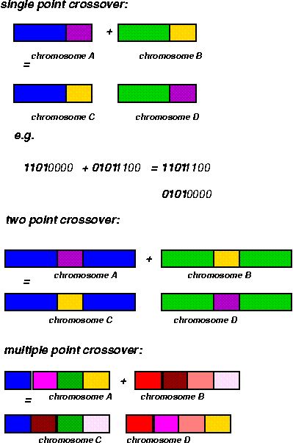
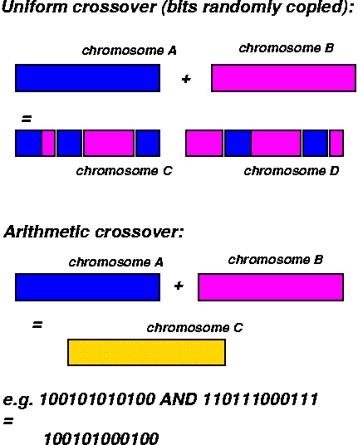
Crossover mechanisms

Slide 22
Replacement Schemes
generational replacement
  entire population is replaced each generation
  non-overlapping population
10111
01000
01011
10010
01001
11001
Selection
Crossover
Mutation
steady state replacement
  a single individual (worst, random) is replaced by
  one offspring
  overlapping population
10010
01001
11001
10010
01001
11001
Selection
Crossover
Mutation
01110

Slide 23
E.g.:Traveling Salesman Problem
city
E
A
F
D
C
segment
G
B
objective: find the shortest tour that visits each city (NP-hard)
a tour is encoded by a sequence AEFCBGD which
specifies the order in which cities are visited
fitness: overall length of the tour
phenotype (tour) is defined by the permutation of genes
rather than their values

Slide 24
E.g.:Traveling Salesman Problem
usual crossover results in invalid tours
AEF|CBGD → AEF DFAB
ECG|DFAB → ECG CBGD
edge recombination operator
parent 1 AEFCBDG
parent 2 ECGDFAB
City | Connections
A | E,D,F,B
B | C,G,A,E
C | F,B,E,G
D | G,A,F
E | A,F,B,C
F | E,C,D,A
G | B,D,C
1. Select a start city
2. Select the neighbor with the minimum number of connections (break ties randomly)
3. Repeat 2 until no more cities are left

Slide 25
Genetic Programming
automatic generation of computer programs
by means of natural evolution see Koza 1999
programs are represented by a parse tree (LISP expression)
tree nodes correspond to functions :
- arithmetic functions {+,-,*,/}
- logarithmic functions {sin,exp}
leaf nodes correspond to terminals :
- input variables {X₁, X₂, X₃}
- constants {0.1, 0.2, 0.5 }
+
X₁
*
tree is parsed from left to right:
(+ X₁ (* X₂ X₃)) X₁+(X₂*X₃)
X₂
X₃

Slide 26
Genetic Programming : Crossover
-
+
parent A
parent B
X₂
/
X₁
*
-
X₁
X₂
X₃
-
X₂
X₃
+
*
/
offspring B
offspring A
X₁
X₂
X₂
X₃
-
X₁
X₂
X₃

